Slide 1


Lesson 11 The world of music
UNIT 3

Slide 2



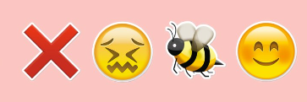


Guess the song!
Divide into two teams. Look at the picture and write down your answer on a piece of paper.
You win a point if you spell and pronounce the name of the song correctly. The winning group gets to listen to one of the songs.
1.
4.
5.
2.
3.
DONT’T WORRY BE HAPPY
DANCING QUEEN
BABY
SUGAR
HAPPY
ABBA
JUSTIN
BIEBER
MAROON 5
BOBBY MCFERRIN
PHARELL WILLIAMS

Slide 3
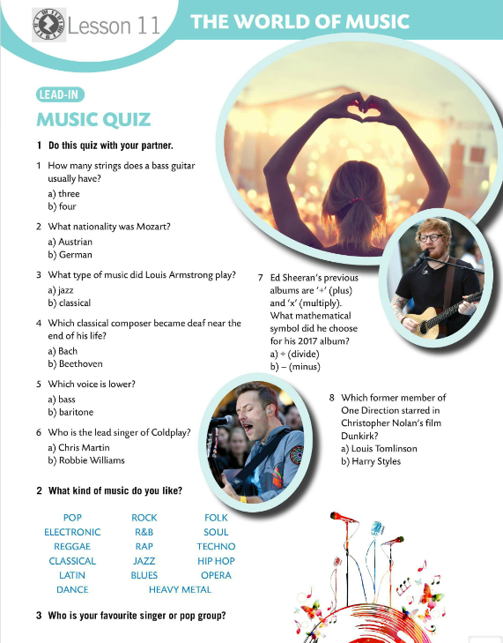
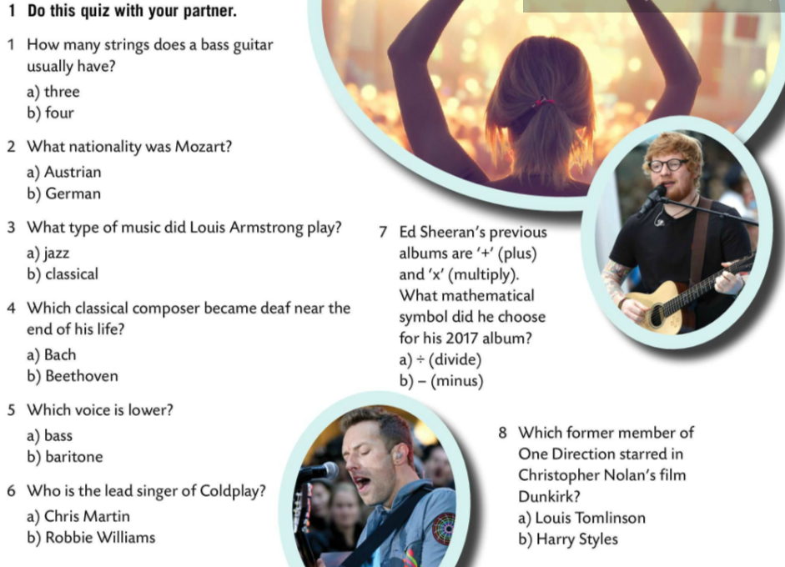
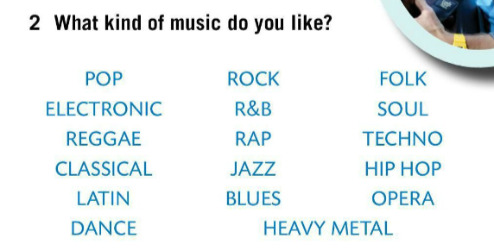
Do this music quiz with your partner.
Check.
What kind of music do you like? Circle.
Why? Explain.
Who is your favourite singer or pop/rock?
Do you have a favourite album? What about a favourite song?
Share your answers.

Slide 4
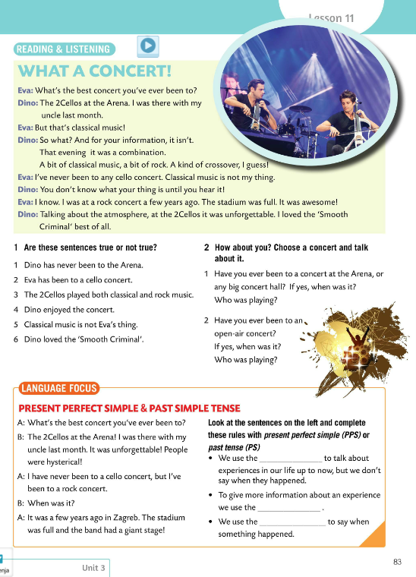

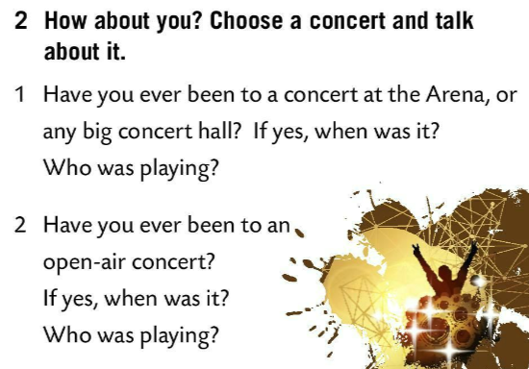
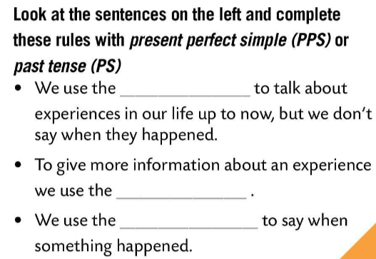
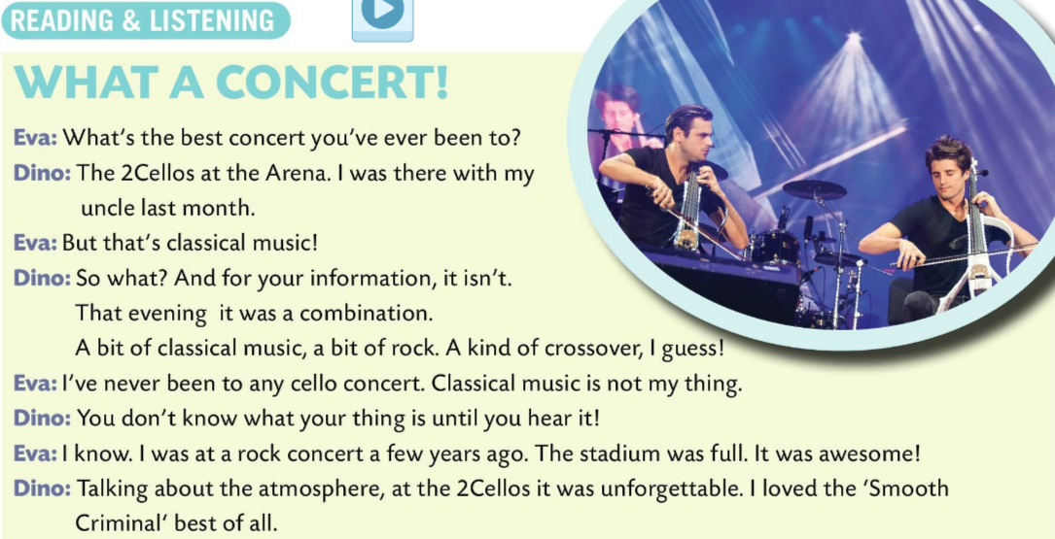
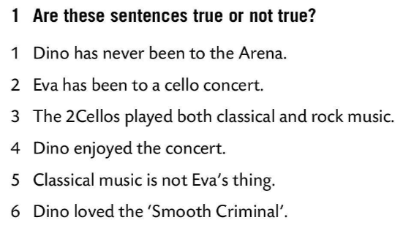
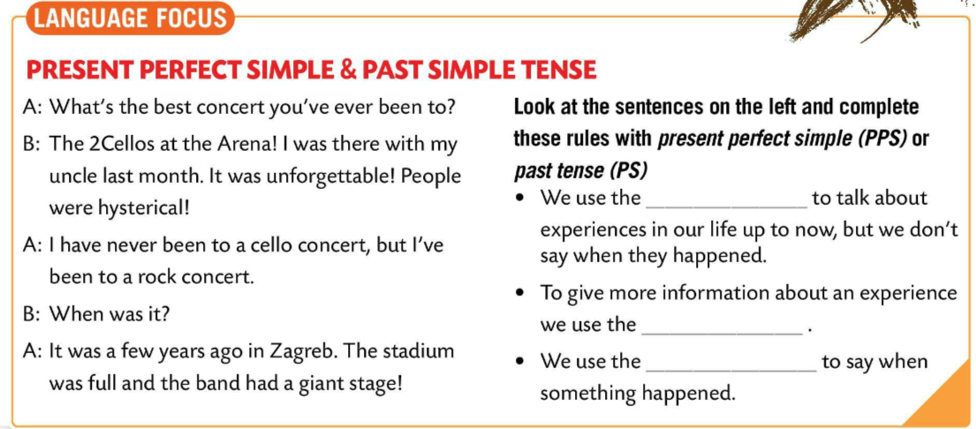
Listen to the dialogue.
Read the dialogue in pairs.
Listen to the dialogue once again and decide if the sentences are true or false.
FALSE
PSS
FALSE
Check.
TRUE
FALSE
How about you? Choose a concert and talk about it.
PS
TRUE
PS
TRUE
Read the sentences in LANGUAGE FOCUS box. Then, complete the rules with present perfect simple (PPS) or past tense (PS).
Check.

Slide 5
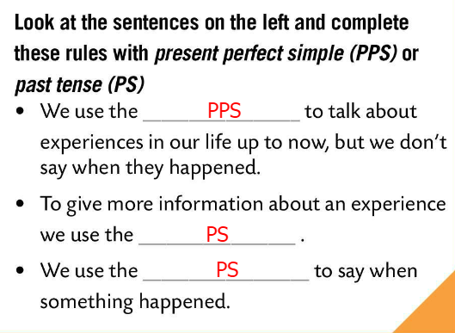
LANGUAGE FOCUS
We use the present perfect simple to talk about experiences in our life up to now, but we don’t say when they happened.
Present perfect simple koristimo kada govorimo o dosadašnjim iskustvima, tj. o iskustvima koje smo doživjeli do trenutka u kojemu govorimo, ali ne govorimo kada su se dogodili.
We use the past tense to give more information about an experience.
Past simple koristimo kada želimo dati više detalja o prošlom iskustvu.
We use the past tense to say when something happened.
Past simple koristimo kada želimo točno reći kada se nešto dogodilo.

Slide 6
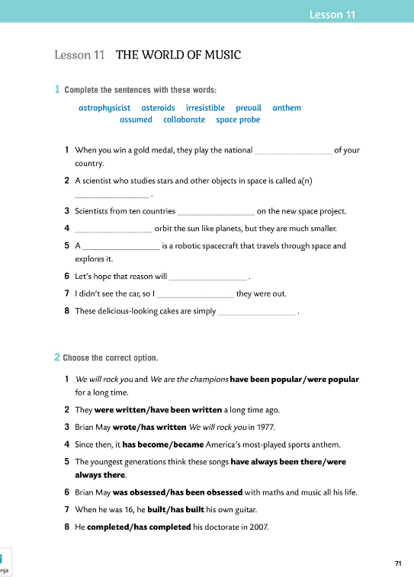

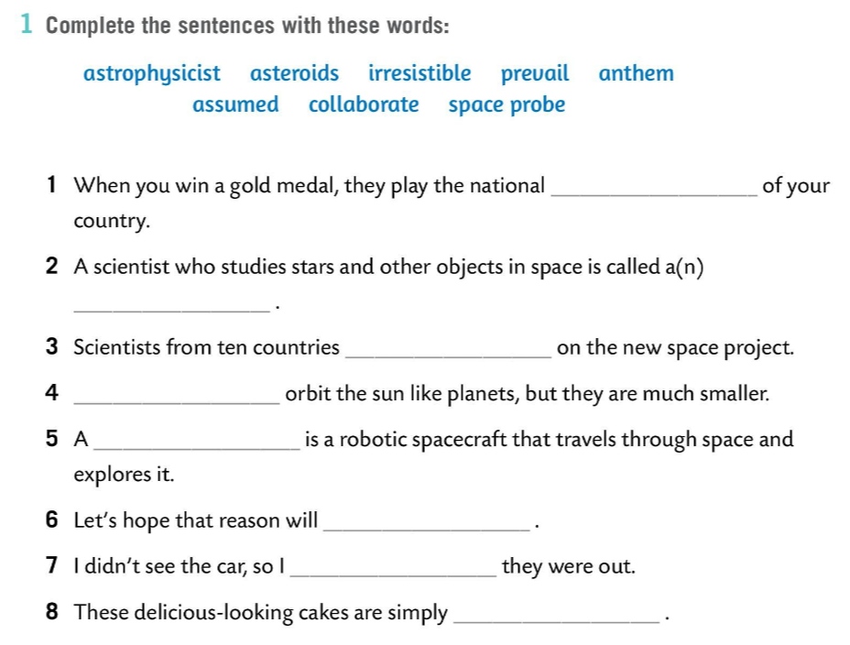
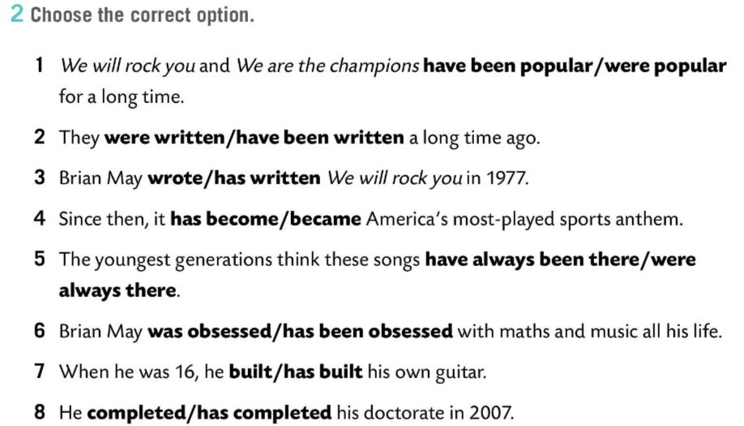
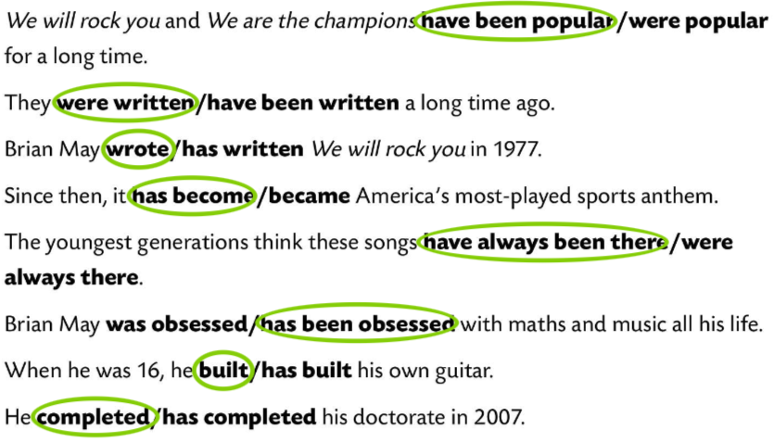
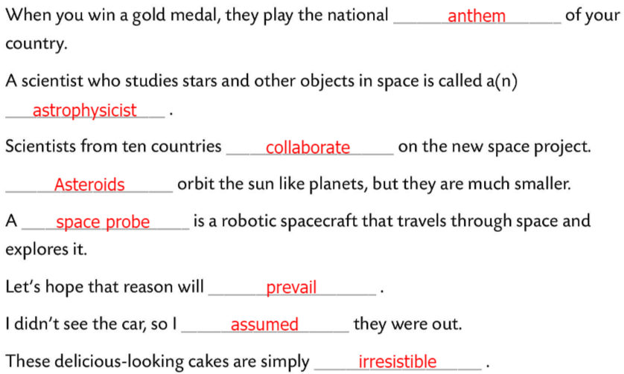
Workbook, page 71
Complete the sentences with the words Task 1.
Check.
Choose the correct option.
Check.

Slide 7
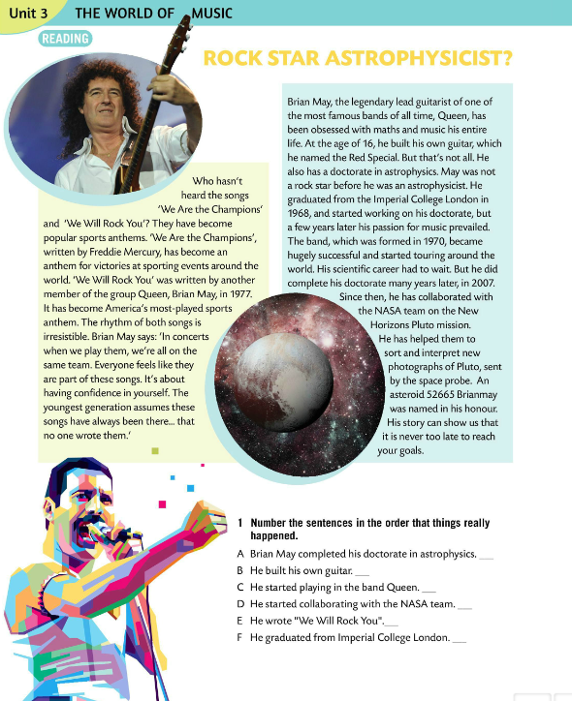
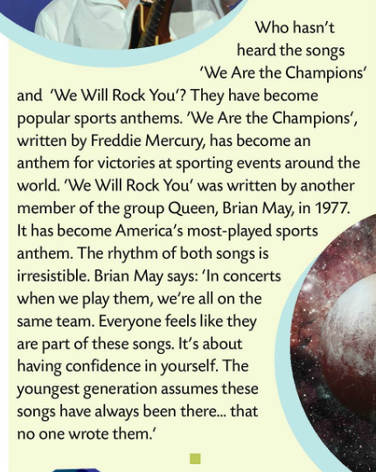
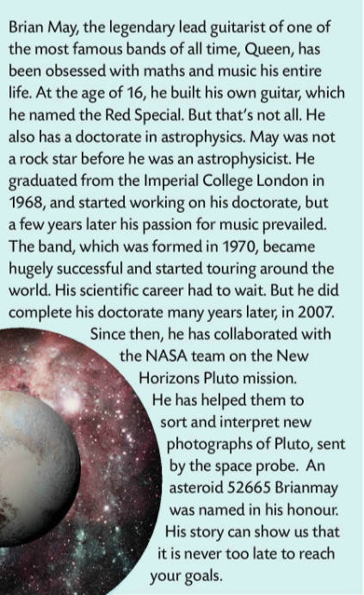
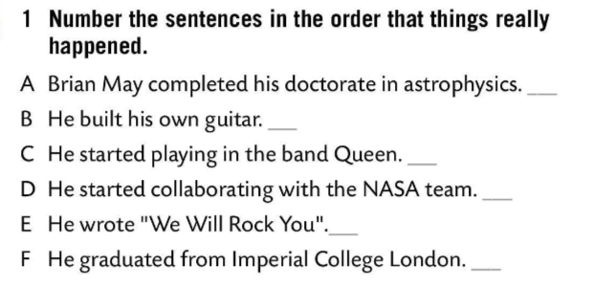
Read the text.
Underline new words and translate them into Croatian.
Number the sentences in the order that things really happened.
5
1
Check.
3
6
4
2
Do you know the names of musical instruments? Play this game in order to find out. https://wordwall.net/play/849/415/915

Slide 8
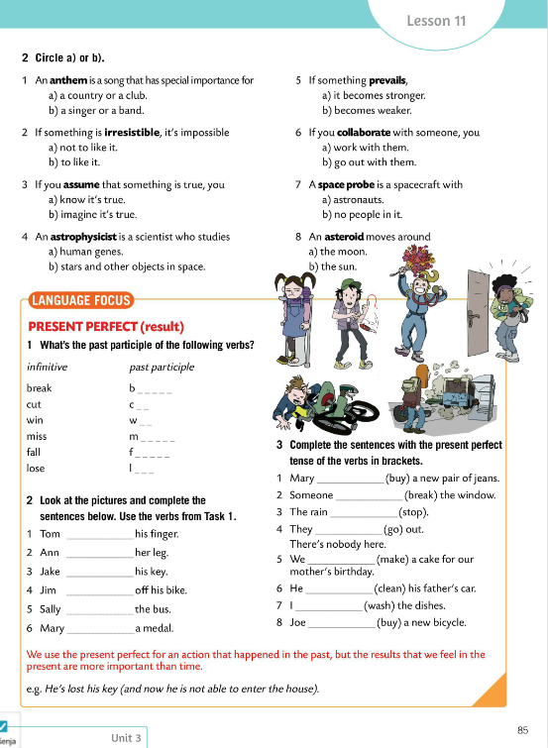
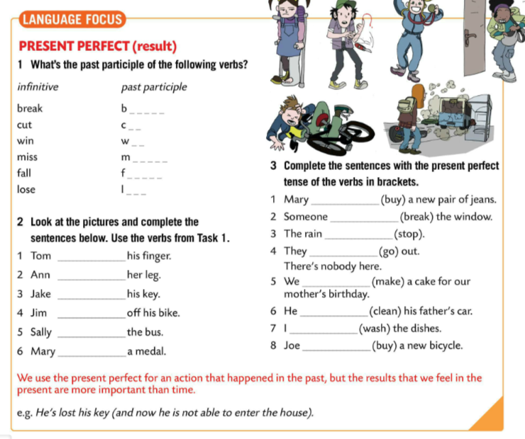
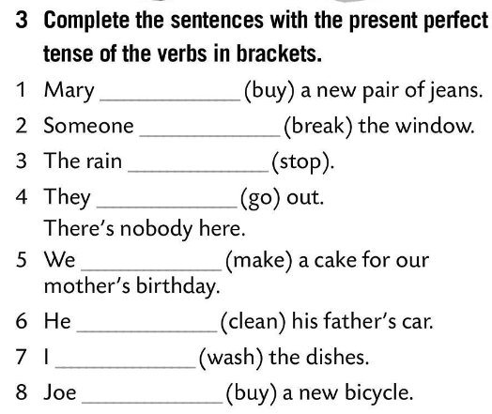
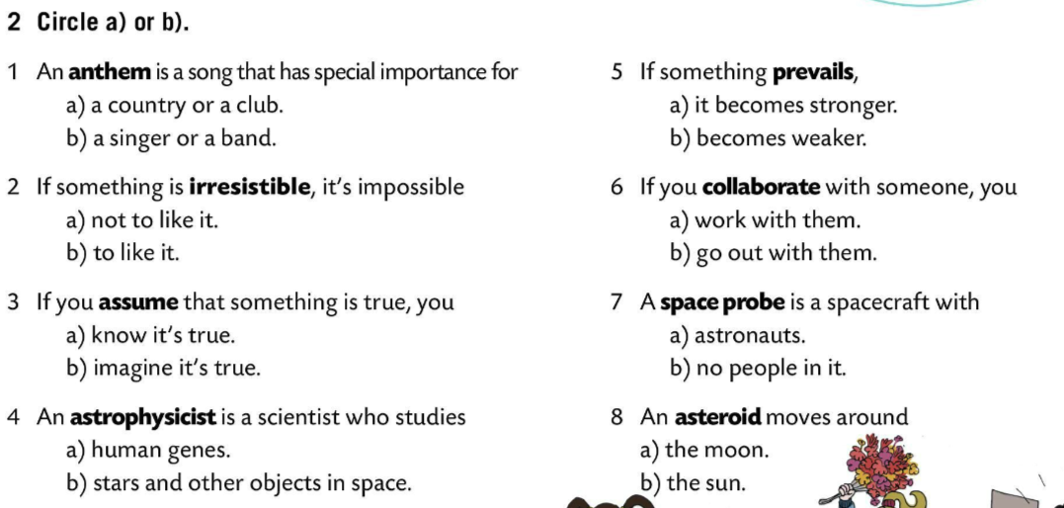
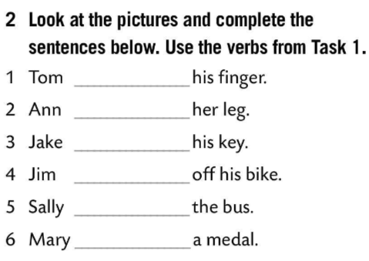
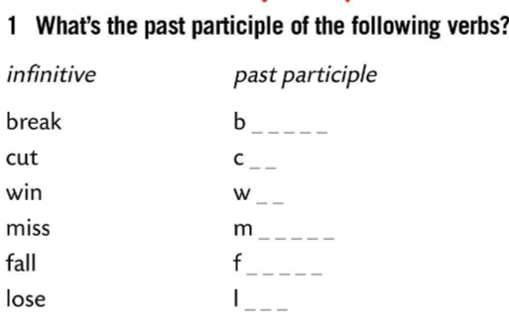
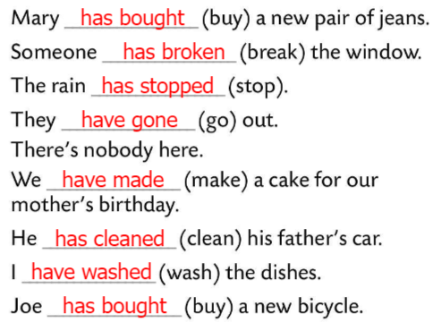
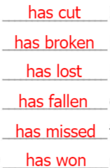
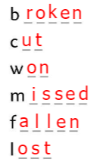
Circle a) or b) in Task 2.
Check.
What is the past participle of the following verbs?
Check.
Look at the pictures and complete the sentences below. Use the verbs from Task 1.
Check.
Complete the sentences with the present perfect tense of the verbs in brackets.
Check.

Slide 9
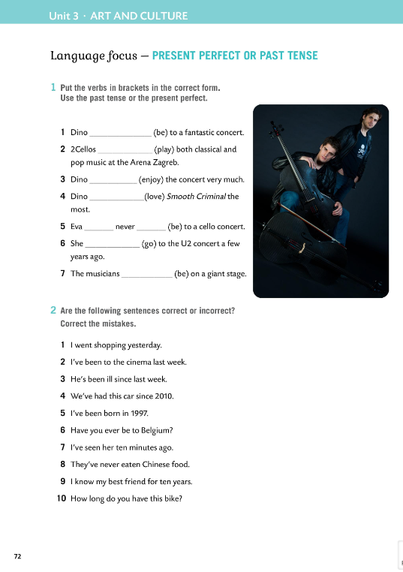
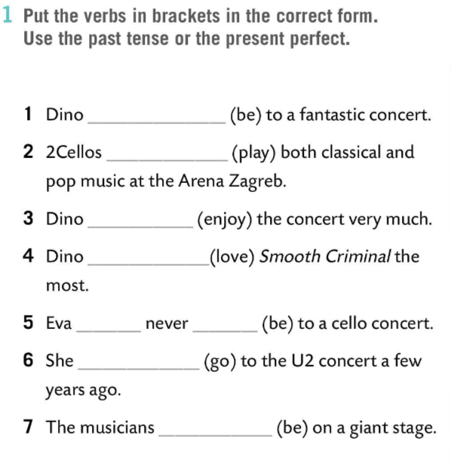
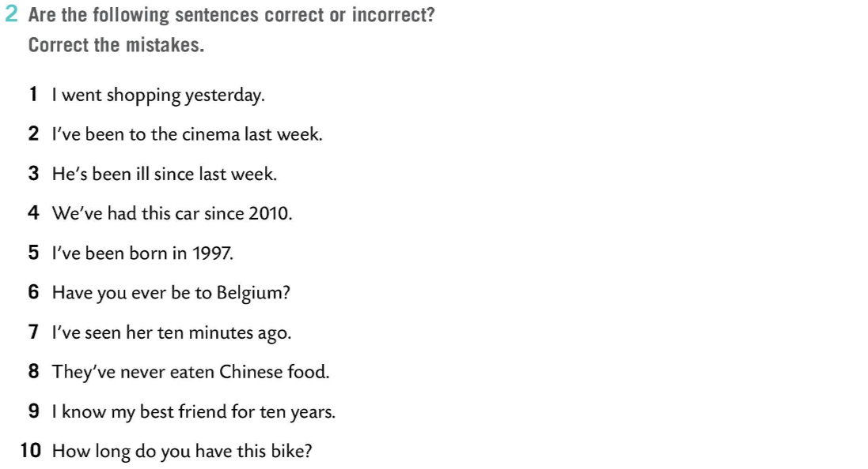
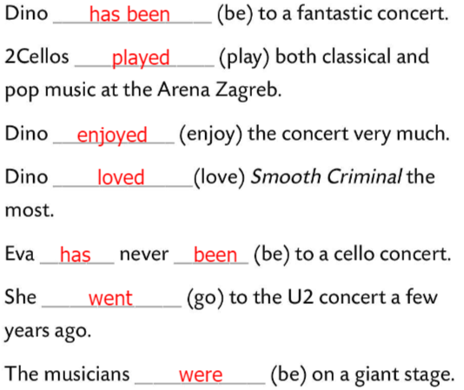
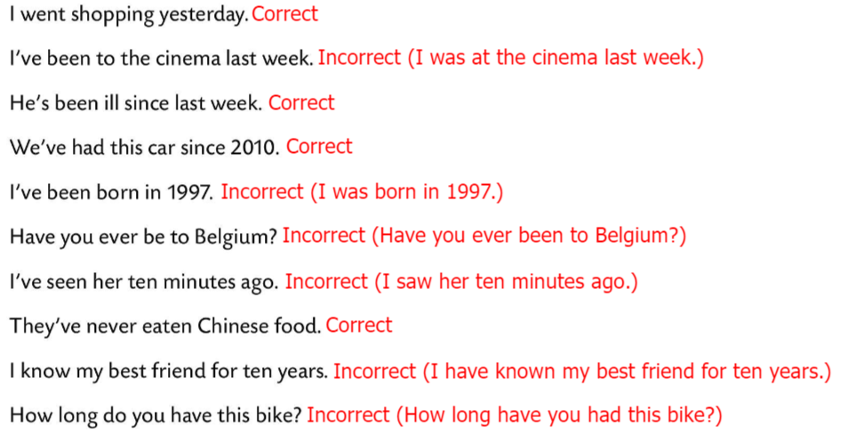
Workbook, page 72
Put the verbs in the brackets in the correct form.
Check.
Are the sentences in Task 2 correct or incorrect? Correct the mistakes.
Check.

Slide 10
LANGUAGE FOCUS
We use the present perfect for an action that happened in the past, but the results that we feel in the present are more important than time.
Present perfect koristimo za opisivanje radnje koja se dogodila u prošlosti, ali čije posljedice, koje su važnije od trenutka kada se radnja dogodila u prošlosti, osjećamo u sadašnjosti.
e.g. He lost his key (and now he can’t get into the house).

Slide 11
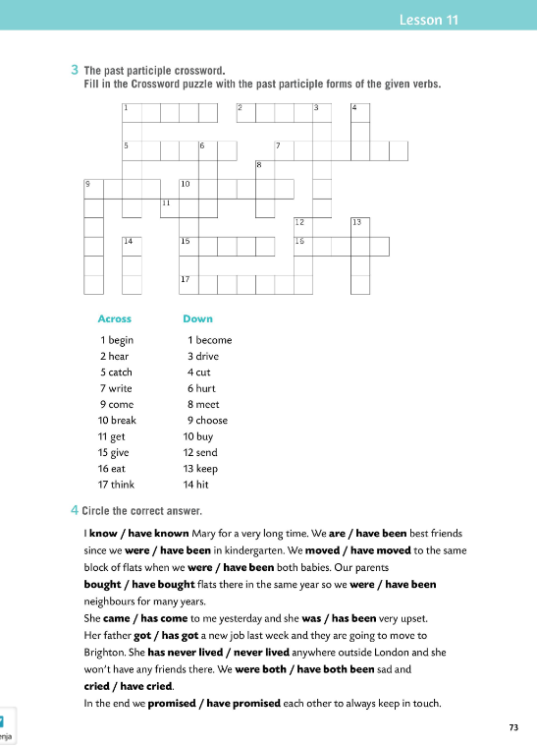
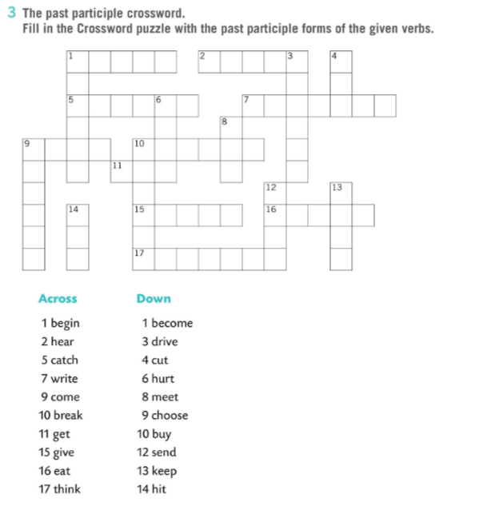
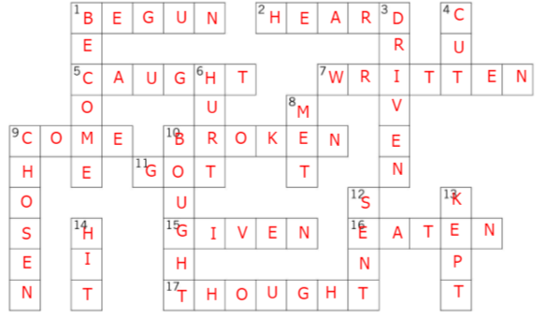
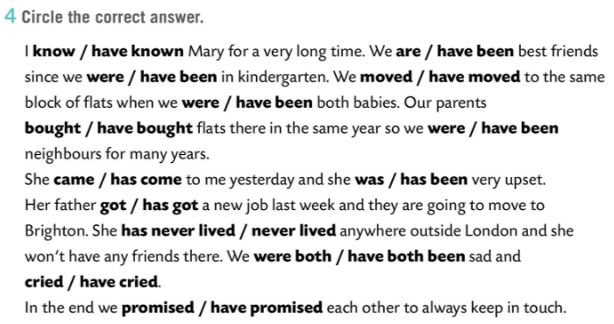
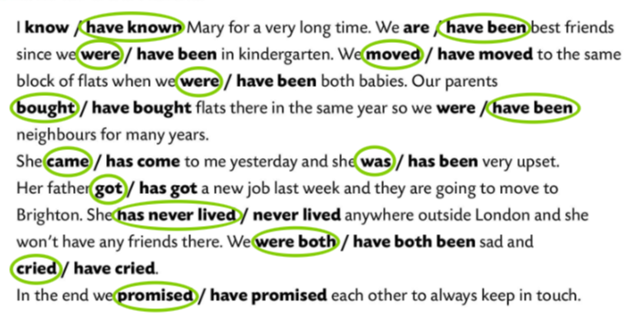
Workbook, page 73
The past participle crossword.
Fill in the crossword puzzle with the past participle forms of the given verbs.
Check.
Circle the correct answer.
Check.

Slide 12
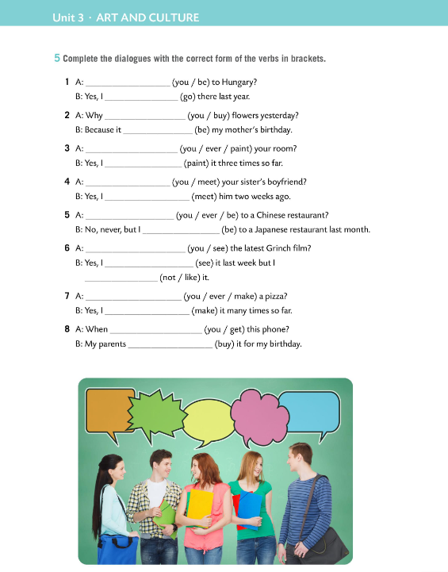
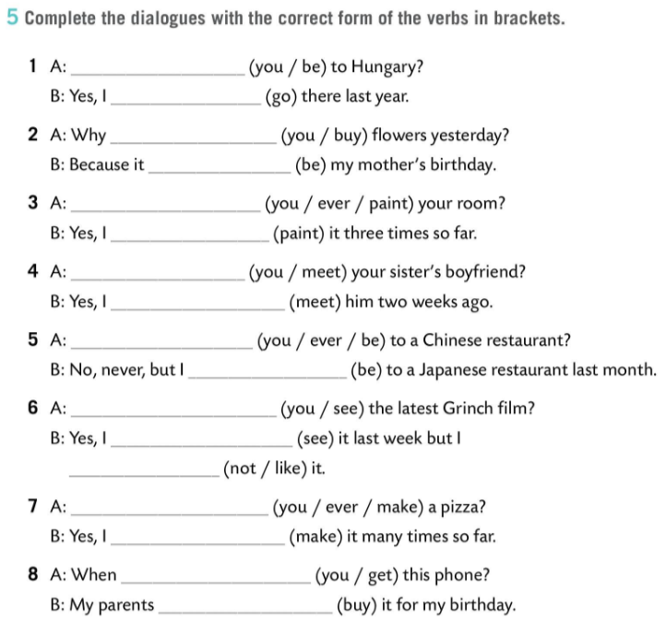
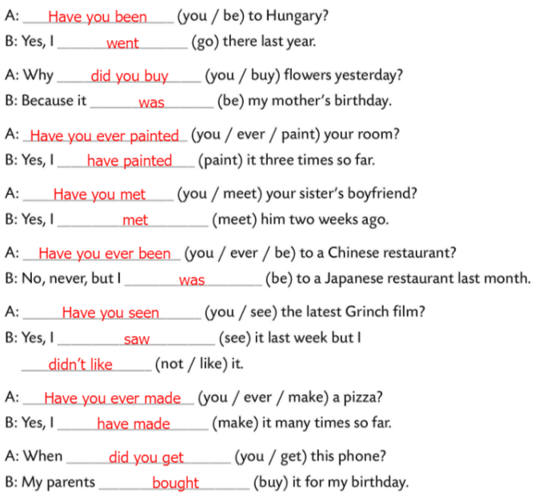
Workbook, page 74
Complete the dialogues with the correct form of the verbs in brackets.
Check.

